Slide 1
Lab R@ts
Team L

Slide 2
Lab R@ts
Bringing together students and experimenters through a friendly and easy to use platform

Slide 3
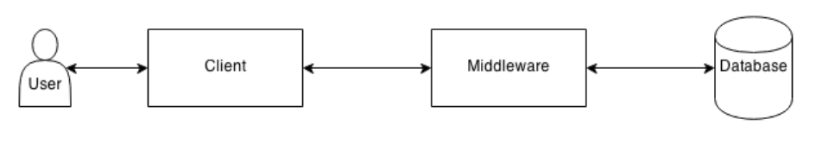
System Architecture
URL + parameters
SQL
JavaScript
CSS.
HTML
AJAX
Data
Web browser,
using HTML/CSS/JS/AJAX
Web Server, with an
Application Server built using Django
SQLite Database Server

Slide 4
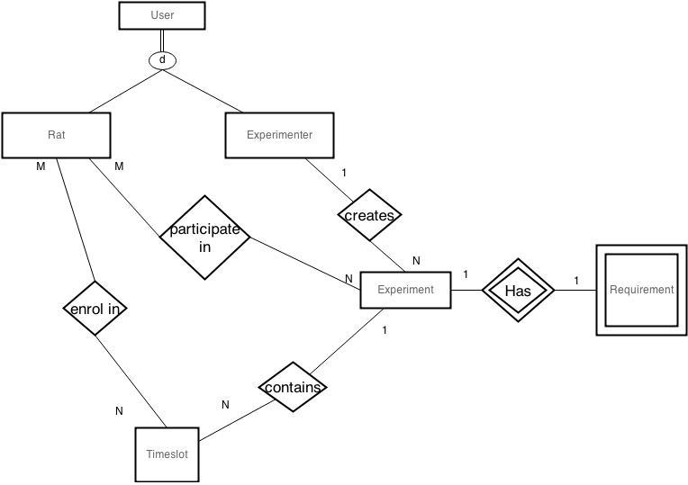
E.R. Diagram

Slide 5
E.R. Diagram - Attributes(1)
User
User
Rat
Attribute | Type
username | String
password | String
email | String
first_name | String
last_name | String
firstLanguage | String
title | String
phone | String
userType | String
picture | ImageField
webpage | String
Attribute | Type
school | String
age | Integer
sex | String
country | String
educationLevel | String
location | String
Experimenter
Attribute | Type

Slide 6
E.R. Diagram - Attributes(2)
Experiment
Attribute | Type
experimentID | Integer
title | String
description | String
max_participants | Integer
num_of_participants | Integer
date_start | Date
Attribute | Type
date_end | Date
tags | String
rewardType | String
rewardAmount | String
status | String
location | String
tag | String

Slide 7
E.R. Diagram - Attributes(3)
Requirement
Timeslot
Attribute | Type
ageMin | Integer
ageMax | Integer
sex | String
firstLanguage | String
educationLevel | String
location | String
Attribute | Type
timeslotID | Integer
date | Date
time_from | Time
time_to | Time

Slide 8
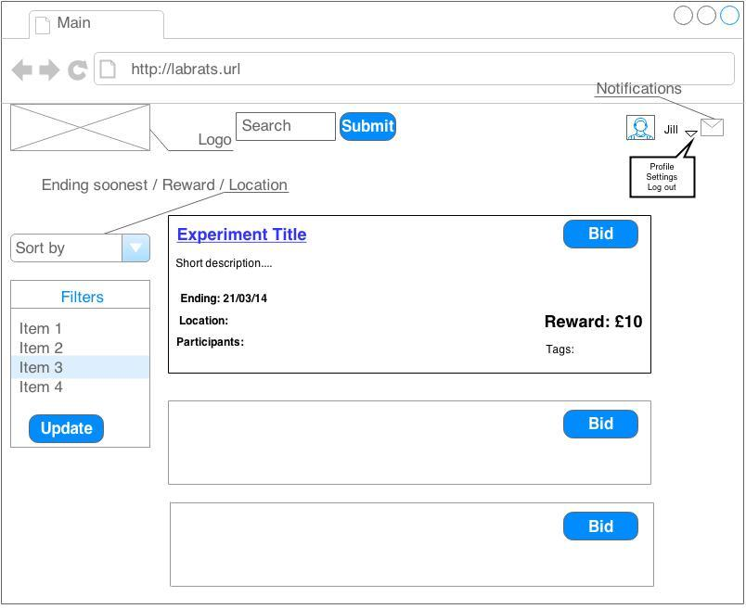
Wireframe(1)

Slide 9
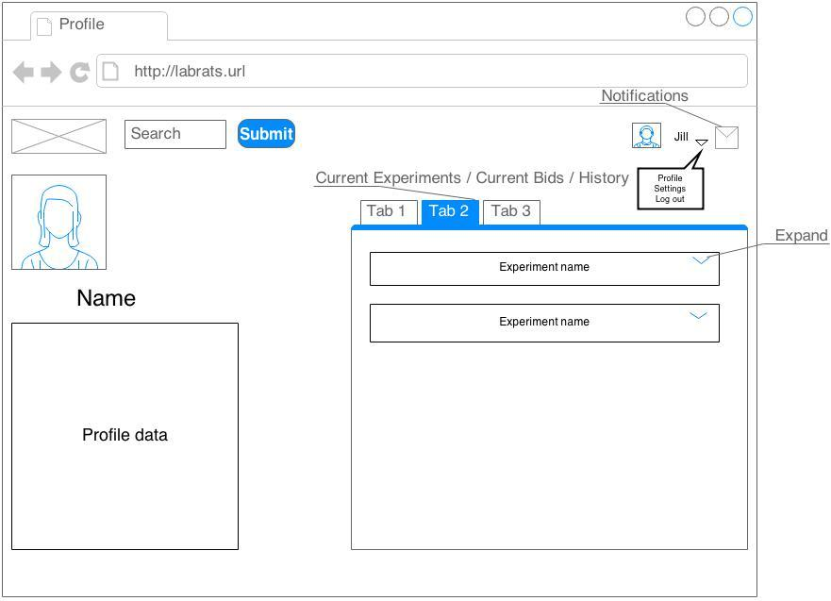
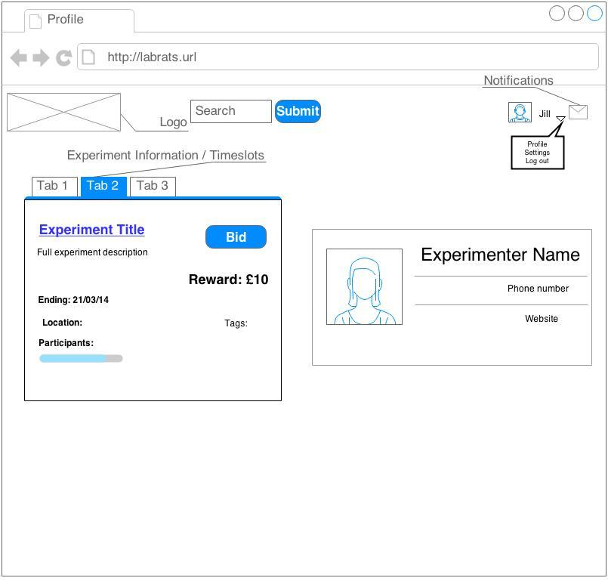
Wireframe(2)

Slide 10
Stand-out features/functions
Recommendations based on frequent tags associated with experiments the user has made bids for.

Slide 11
Specification List
Must Have:
create experiments
log in/out
bid on experiment
browse through experiments
notification via email and interface if bid accepted
view experiment details
screen participants
accept/decline bid
Could Have:
view experimenter/fellow R@ts profile page n
offer slots for experiments
Should Have:
filter experiments
students browse through past experiments
students browse through experiments they bid on
summary of past 5 experiments (all)
summary of past 5 experiments with up and coming dates y
summary of top 5 highest paying experiments y
Would Have:
email list of up and coming experiments n
recommendations based on tags

Slide 12
Achieved functionality
Must Have:
create experiments
log in/out
bid on experiment
browse through experiments
notification via email and interface if bid accepted
view experiment details
screen participants
accept/decline bid
Could Have:
offer slots for experiments
Should Have:
filter experiments
students browse through past experiments
students browse through experiments they bid on
summary of past all experiments (and not 5)
summary of past all experiments with up and coming dates (and not 5)
summary of all highest paying experiments (and not 5)
Would Have:
recommendations based on tags

Slide 13
Missing functionality:
Could Have:
view experimenter/fellow R@ts profile page
Would Have:
email list of up and coming experiments

Slide 14

User Personas
Christian Troy
Undergraduate Mechanical Engineering Student
Profile:
21 years old
first year student
has plenty of spare time on his hands
interested in making some extra money in his spare time
has bad eyesight
Critical Needs:
browse through experiments
find experiments that pay the most money
get notified when he has to attend an experiment
choose a time which does not conflict with his lectures
Opportunities to improve:
notified via email when accepted to an experiment
filter experiments which are appropriate for him
notified the day before an experiment

Slide 15

User Personas
Danielle Perry
University teacher in the School of Psychology
Profile:
32 years old
Honours and PhD in Psychology
mother of 3
researches psychophysiological insomnia
lecturer and tutor for lvl 3 behavioural patterns course
has a very busy schedule
Critical Needs:
add her experiment to the site
quickly approve or reject participants
set timeslots which match her schedule
Opportunities to improve:
notified when people have bid on her experiment
notified the day before an experiment

Slide 16
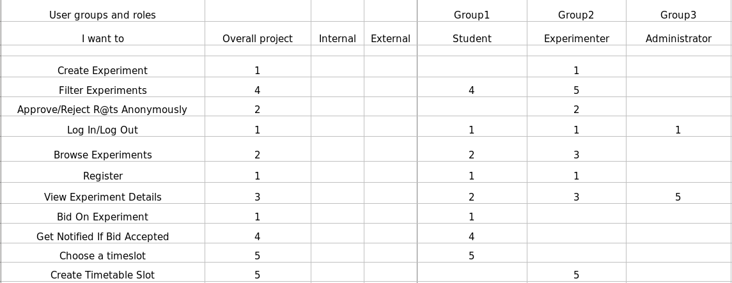
User Needs Matrix

Slide 17
URLs and Site Map
Notable URLs:
/
/register
/login
/profile/{username}
/editProfile
/experiment/{experiment_name}
/experiment/create
/search (template does not exist)
/tag/{tag_name}
Site Map
/
/register
/login
/profile/{id}
/editProfile
/experiment/{experiment_name}
/create
/search
/tag/{tag_name}

